Slide 1
Docker and Kubernetes
What I learned at @DevOpsGirls Workshop
Notes:
Hey y’all!
Notes throughout slides are a bit messy - lots of notes available in repo

Slide 2
Disclaimer
Notes:
I’m a beginner!
Aim is to give you an overview of Docker + Kubernetes, the workshop I attended, and share resources to learn more :) - to spark an interest and give a bit more info - Im very open to learning more if anyone has comments and suggestions of resources /feedback etc! Some of it is text heavy
Thanks to Gabe Wong @gabrielwongau from the Cybersecurity bootcamp for his help! I think in the cloud/cybersecurity bootcamp they focus a bit more on devops/CI+CD concepts than we do in web dev, so there is likely a better understanding of docker/kubernetes amongst their students? He was helpful with feedback + factchecking
I found the workshop a bit hard to grasp conceptually in a few areas, I’m doing this talk to better understand it myself!

Slide 3
Overview of Workshop Goals
0. Docker concepts
Docker basics - basic commands to run containers and pull images
Creating Docker images
Docker tagging - what are tags, how to publish your images
Kubernetes concepts - what it is, why companies use it
Kubernetes basics and the command line - creating our first objects
Deployments and Services - making pods available and updating them at scale
Labels - tying everything together
Notes:
This can be seen in the overview of the repo

Slide 4
Why?

Slide 5
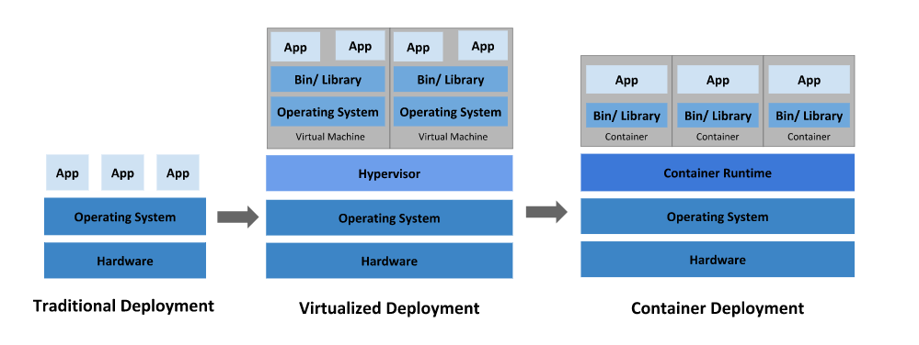
The Problem
Notes:
Deployment is complicated!
Traditional - we used to deploy applications against operating systems installed on hardware that we bought. (Much like how you'd install software on your Windows operating system, which is installed on your laptop. making sure its all duplicated correctly on diff hardware
Problems with traditional deployment:
Different Environments: having a different environment for my development work on my laptop vs. on the production server.
Configuration Management: not being able to easily configuration manage the application environment
Collaboration: not being able to easily replicate an application environment (either development or production) for a colleague/friend “works on my machine”
Not scaleable/easily maintainable
Virtualised - hypervisors - independent of hardware, so you can run on diff servers - but over time people started using containers
Over time- started having Hypervisors - software that would allow you to emulate hardware, and install another operating system on top of it.
The operating system ( or to be more correct, the kernel ) began to be reused, and all you had to do was pack up just what you need - the libraries, or anything "uncommon" that doesn't exist in the kernel by default. - in this way, docker gives us a container of the essentials to run our app

Slide 6
The SOlution

Slide 7
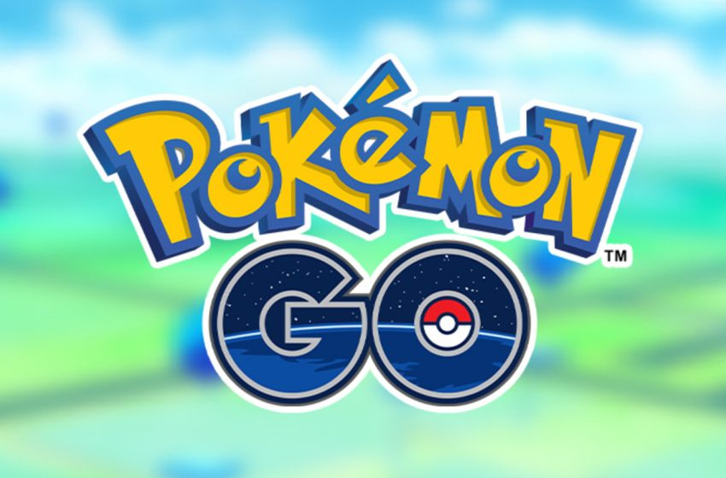
https://scotch.io/@pavan-belagatti/pokemon-go-a-successful-kubernetes-story
Notes:
Pokemon go example - thanks Gabe!
“ The Challenge The horizontal scaling on one side but Pokemon Go also faced a severe challenge when it came to vertical scaling because of the real-time activity by millions of users worldwide. Niantic was not prepared for this.
The Solution The magic of containers. The application logic for the game ran on Google Container Engine (GKE) powered by the open-source Kubernetes project.
Niantic chose GKE for its ability to orchestrate their container cluster at planetary-scale, freeing its team to focus on deploying live changes for their players. In this way, Niantic used Google Cloud to turn Pokémon GO into a service for millions of players, continuously adapting and improving. This got them more time to concentrate on building the game's application logic and new features rather than worrying about the scaling part.
“Going Viral” is not always easy to predict but you can always have Kubernetes in your tech stack. “

Slide 8
WHY Use Docker?
Portability
Isolation
Solves the issue of deploying applications against OS installed on hardware that had been purchased
CI + CD
Abstraction
Notes:
Portability - docker containerised apps will run the same way regardless of host OS, as long as its compatible docker host
Isolation - everything you need to run your app is encapsulated inside the image/container - no missing dependencies on destination host - not relying on preexisting dependencies or installs
solves
Continuous integration and delivery of software
Abstraction - your software is all bundled up to run on any machine, regardless of hardware

Slide 9
Why Use Kubernetes?
Manage containers
Abstraction
Built in redundancies+failure tolerance
Speeds up release lifecycle
Powerful benefits with Docker
Notes:
Lot of the same reasons
Manage containers, how they are deployed, how they talk to each other
Abstraction - Allows you to abstract away your infrastructure and release your code into the cloud
redundancies
Release lifecycle
Together, docker and kubernetes are a powerful tool for achieving CI+CD and containerising/abstracting apps - ready to go into cloud

Slide 10
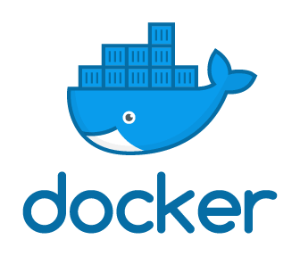

Slide 11
Docker SETUP
You need to install docker on Windows/ Mac
Signup to Docker Hub
Signup for Google cloud to use GKE
(can also use AWS and Azure)
Installing Docker on windows:
If you don’t have enterprise or pro you’ll need Docker Toolbox
You need to enable virtualisation on your BIOS
I completed the workshop in google cloud’s terminal because my CPU wasn’t virtualisation enabled
Notes:
But i had issues with toolbox installation
And I didn’t want to mess with my bios during the workshop
Google cloud trial includes $300AUD of credit - mine didn’t ask for card details
If it does, make sure you delete your projects after if you don’t want to be charged
Google cloud terminal is easy to use
After setup you’re good to go and follow repo instructions

Slide 12
What is Docker?
From wikipedia:
“Docker is a set of platform as a service products that use OS-level virtualization to deliver software in packages called containers. Containers are isolated from one another and bundle their own software, libraries and configuration files; they can communicate with each other through well-defined channels.”
Used by: Spotify, Yelp, eBay, Expedia, Groupon, ING, The New York Times, Oxford University Press, PayPal, Shopify, The Washington Post and Uber.
Notes:
Basically it uses virtualisation to deliver software in packages called containers
Let’s try to gain a better understanding of what this means in practice...

Slide 13
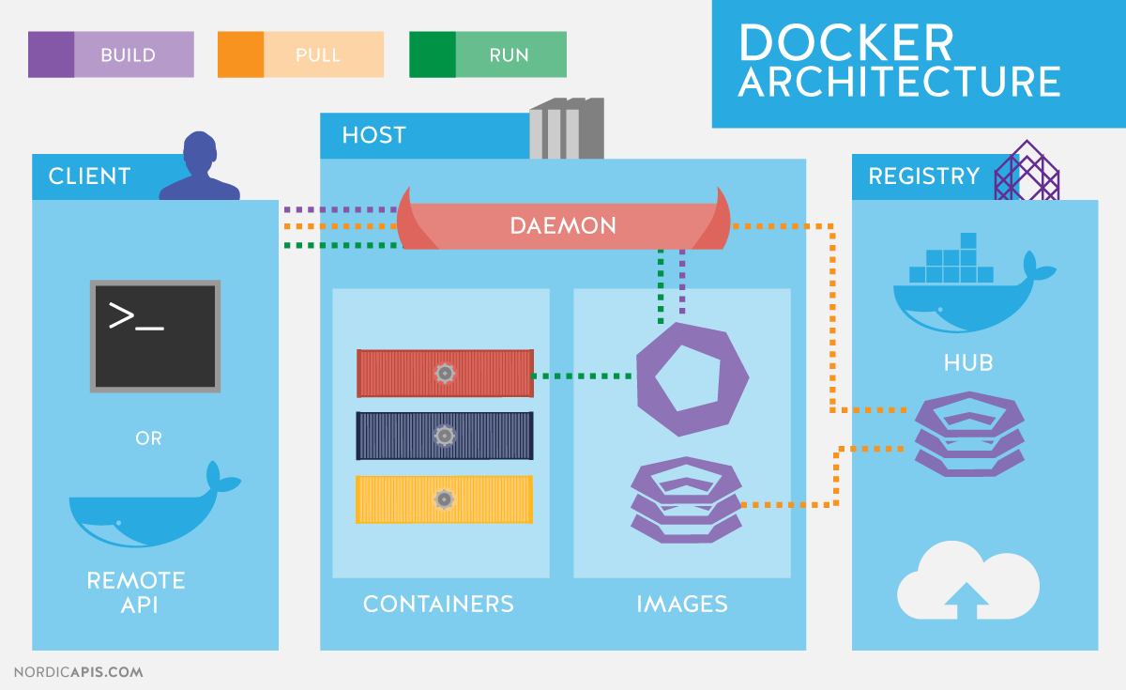
Intro to Docker
Key Terms:
Client
Host
Registry
Image/Container
Notes:
Core concepts/terms: Client, Host, Registry, Image
The Client - primary way of interacting with the Docker host. the Docker command line interacts with the Docker server. Client - In very much the same way that client applications talk to an API, docker CLI talks to docker server.
The Docker Host - the service that runs the API and the daemon that manages your images and containers. Host -Note that we have this annotated as DOCKER_HOST, because while this is usually installed in the same system as the Client, your Docker Host can be in another machine.
The Registry is where your images are stored. (kinda like a database)
Docker Image: a file, composed of multiple layers (instructions), used to execute code. When this code is being executed it’s a container.
Image: When this code is in execution and is able to read/write is when we consider it a container.
In short, an image is an inert container, and a container is an image that is running.

Slide 14
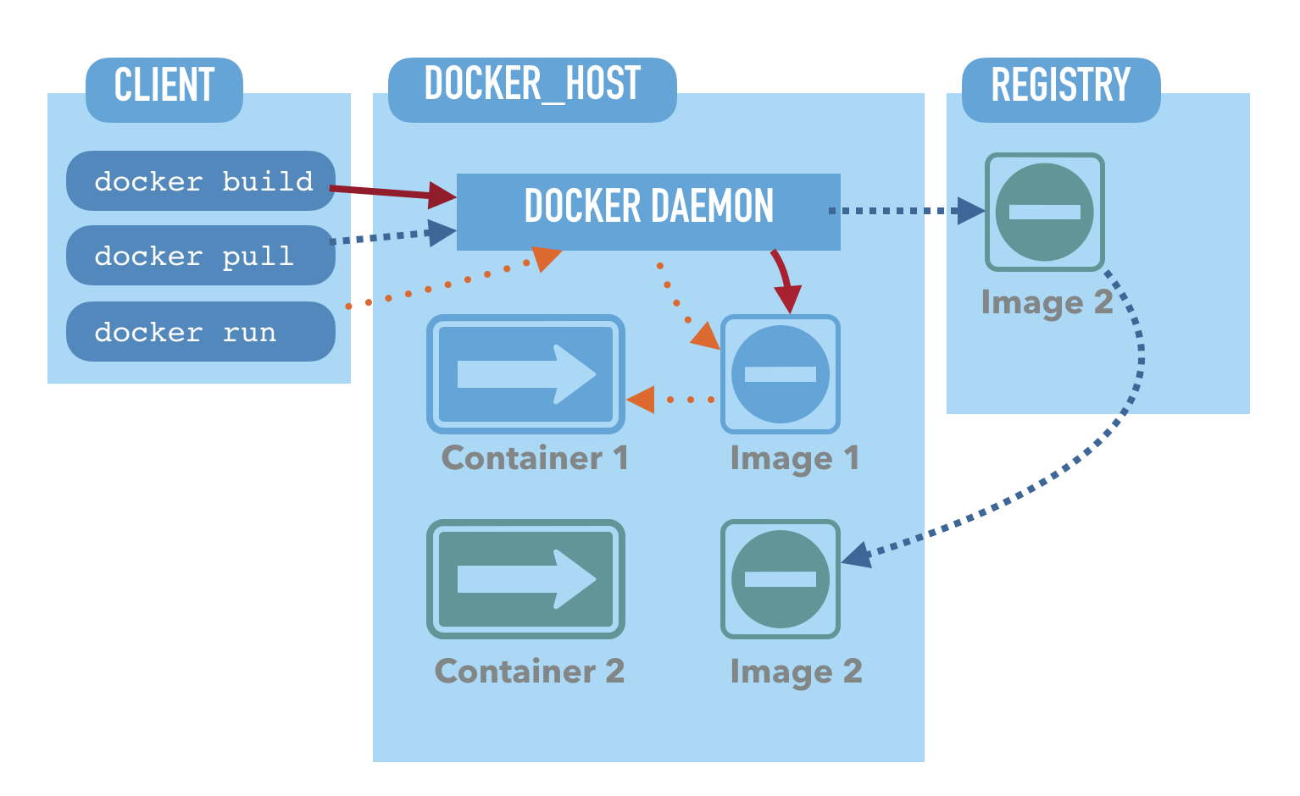
Notes:
Understanding this image:
Client - how we interact with the docker host/server
Build - builds Docker images from a Dockerfile
Pull - your Docker Host downloads an image from the registry (but does not run it). Docker tries to see if the image you're trying to run exists locally - then pulls from somewhere else if it does not exist.
Run - loads up specified image then runs specified command
Host - the service that runs the API and the daemon that manages your images and containers.
Daemon - server that runs on linux - exposes a REST API. docker CLI is a command line tool that allows you to talk to the daemon. Both included on install of docker
Container - an image that’s running (being executed, able to read/write)
Image - a file, composed of multiple layers, used to execute code
Registry
Hosts images like a DB - storage and content delivery system - houses your named docker images
Users interact with a registry by using docker push and pull commands

Slide 15
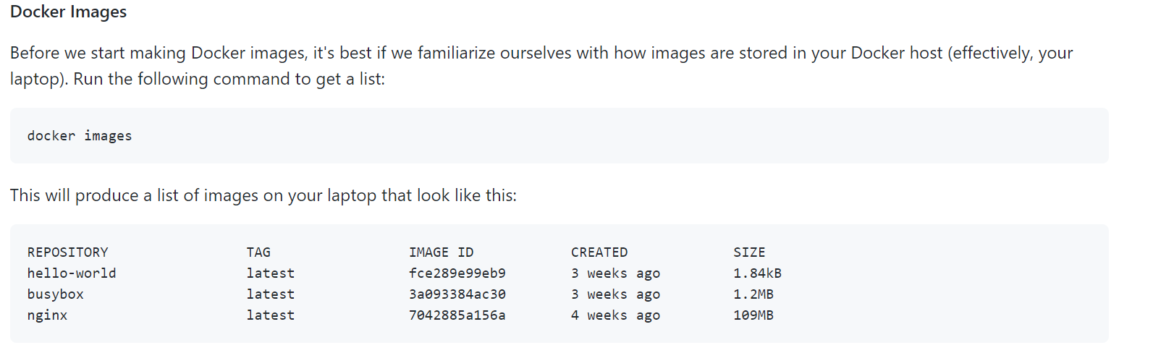
Images
Notes:
Thats what an image will look like on the CLI (g cloud terminal)
Images can have multiple tags - that refer to the same image - here they are all tagged as latest but tags can be anything
Can access images via tag
Just to give you an idea of visualising what it will look like in your terminal
I know i really struggled with the idea of an image- it is NOT a picture haha
We build our images from the dockerfile
And then run them - and access them on your browser via an IP address or via the CLI via ‘curl’ (eg HTML page)

Slide 16
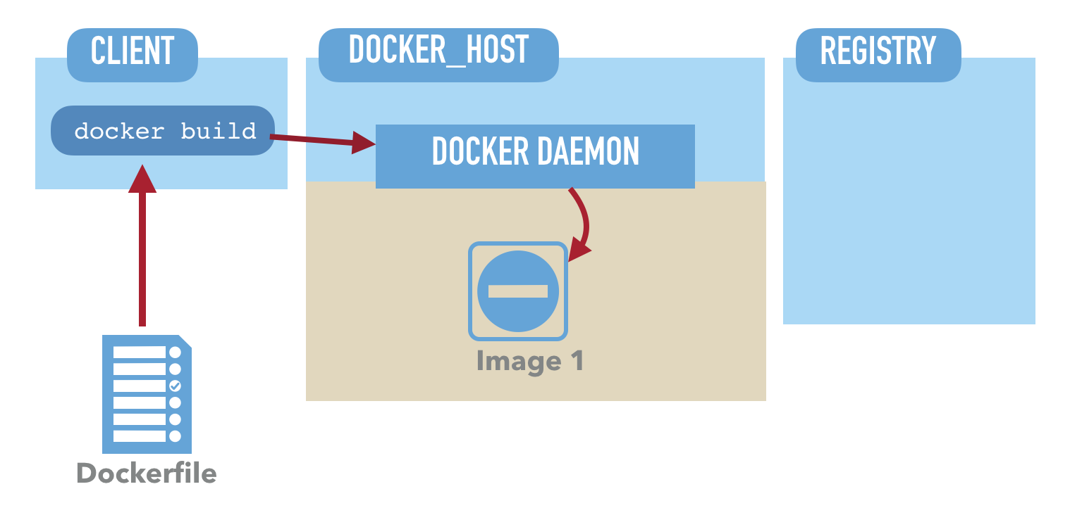
Dockerfile
Notes:
A dockerfile is the traditional naming of a file which contains instructions on how to build an image.

Slide 17
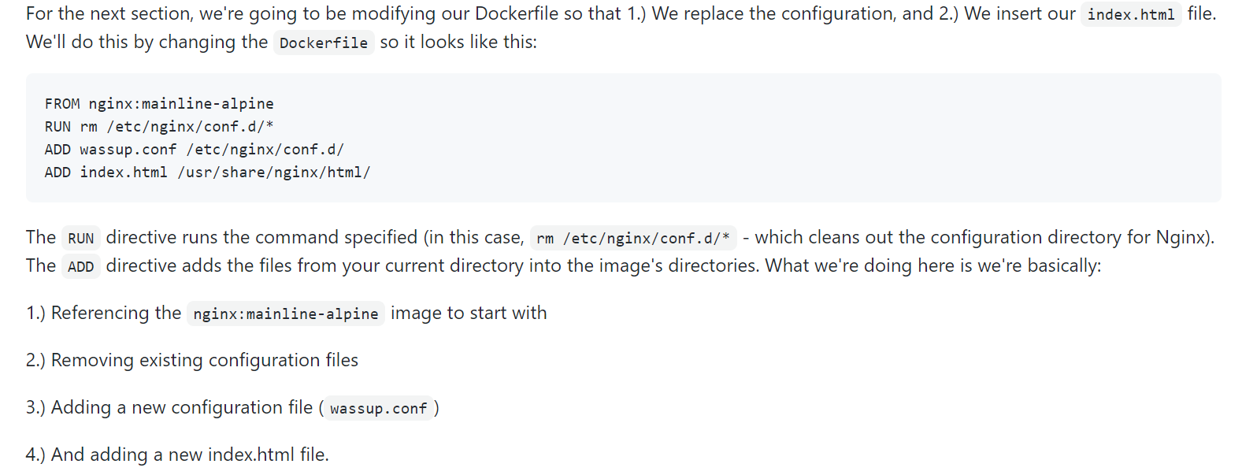
Dockerfile cont
Notes:
This is what the commands in the dockerfile actually look like - to build the image
In this case they’re referring to the repo which I cloned to the gcloud console but can clone it locally

Slide 18
Overview of Workshop Docker content
Docker concepts
Pulled images from registry
Viewed images via CLI
Ran a container
Made our own docker images with dockerfile + viewed on browser
Learned about tags, and created a repository on Docker Hub
https://github.com/DevOps-Girls/from-docker-to-kubernetes
Notes:
Growing quite long so i didn’t go over much of this in detail, but this is what we did during workshop, if you want to follow the workshop exactly, the repo is available!
Lots of docker containers in the wild, you can go and pull the wordpress container apparently
Next up...

Slide 19
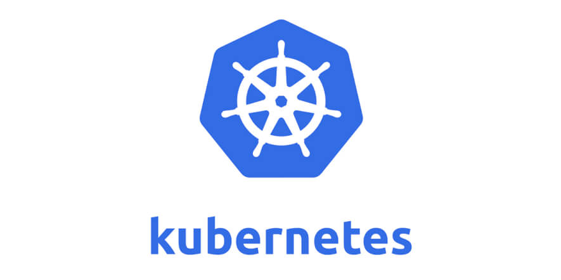

Slide 20
What is Kubernetes?
From Kubernetes.io:
“Kubernetes is a portable, extensible, open-source platform for managing containerized workloads and services, that facilitates both declarative configuration and automation. It has a large, rapidly growing ecosystem. Kubernetes services, support, and tools are widely available.”
Used by: google, shopify, slack, deliveryhero
Notes:
From wikipedia
People get confused between docker and kubernetes - basically, docker creates containers, and kubernetes manages them. You can use just one or both depending on your application needs/scale
Kubernetes is greek for helmsman or pilot (their logo is a boat wheel)
Originally designed by google and perfected over 15years of managing workloads there - they run billions of containers per week (containers are a baby computer inside another computer)
I like wikipedia’s definition also:
Wikipedia: Kubernetes is an open-source container-orchestration system for automating computer application deployment, scaling, and management. It was originally designed by Google and is now maintained by the Cloud Native Computing Foundation.”

Slide 21
Intro to Kubernetes
https://www.youtube.com/watch?v=K38LpW2L2cA
Core terms: pods, containers, deployment, services, ingress controller
Can create multiple types of services in Kubernetes
“If a Docker container provides you with a way to make self-enclosed images, Kubernetes provides you with a way to make them available to the world.”
Notes:
Pods -can be a single container, or a group of containers that are deployed on a host. Within a pod, all containers can talk to each other directly. You reach a pod through its IP address.
Containers - live inside pods
In general use however, companies generally like to use one container per pod. terms Pod and Container often used interchangeably.
Deployment - one or more pods
Services - grouped pods (can be grouped by label, which is altered via its YAML file)
Ingress controller - controls how external internet traffic accesses your deployment within your service
Deployment, service and ingress controller are all controlled via YAML files
Many services - loadbalancer (workshop), cluster IP, nodeport, etc

Slide 22
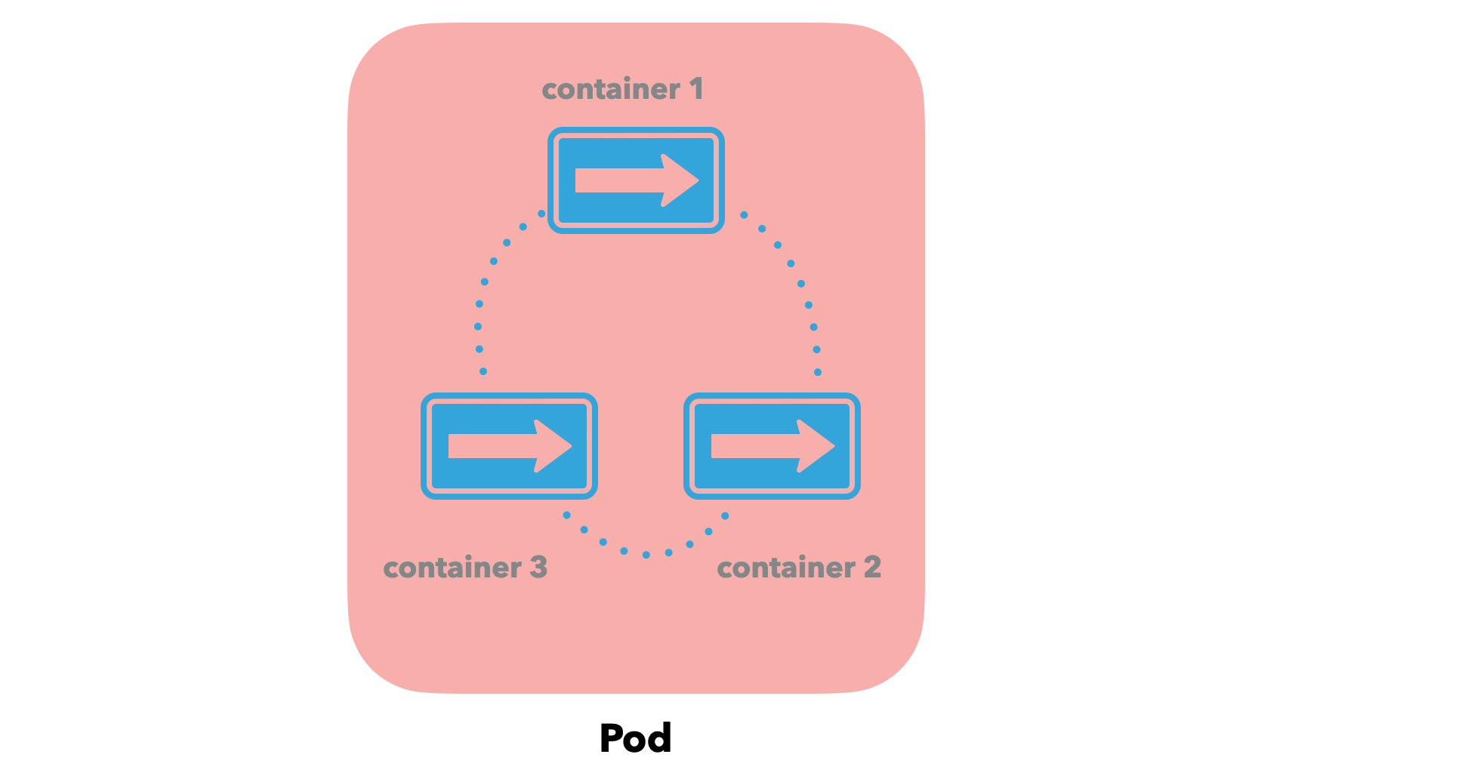
pods
Notes:
Pods -can be a single container, or a group of containers that are deployed on a host. Within a pod, all containers can talk to each other directly. You reach a pod through its IP address.

Slide 23
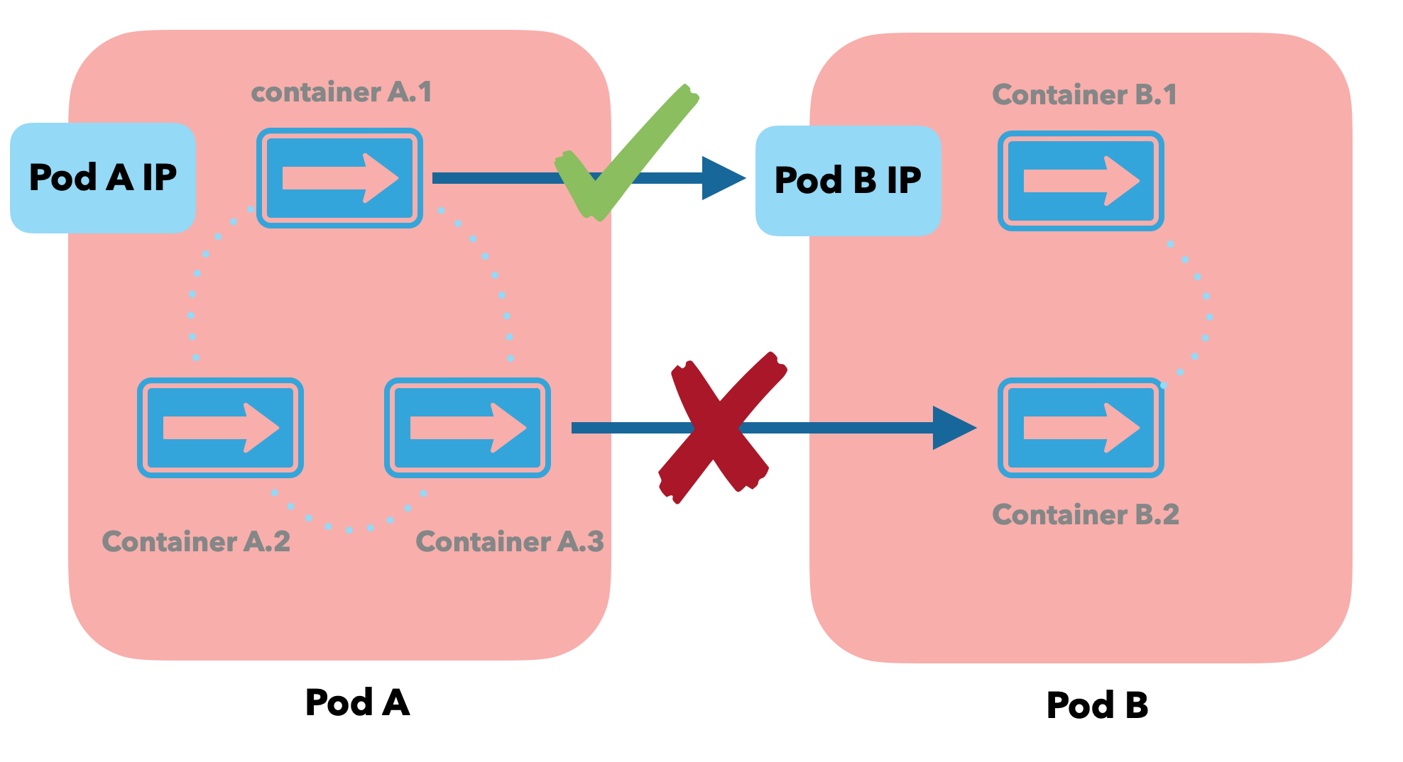
If these pods could talk...
Notes:
Pods cannot talk to the containers in another pod directly. If say, a container (Container A.1) which is in Pod A wants to talk to Container B.1 in Pod B directly, it cannot do so - Container A.1 can only talk to Container B.1 if Container B.1 is exposed by Pod B.
Pods talk to each other via exposed IP addreses

Slide 24
Overview of Workshop Kubernetes Content
Kubernetes concepts - API server, controller, scheduler, replica, kubelets, kube-proxy
Running kubernetes commands in GKE - using kubectl command to talk to API server
Using YAML files to describe+edit pods
Deployments and services -creating multiple pods
Deployments and labels/selectors - associating services based on key-value pairs
Notes:
Again I cant go into much detail here in lightning talk, but this is an overview of what we achieved in the workshop
Terms overview from repo:
In the above example, the primary unit contains multiple services.
The API server is the interface for internal and external services. When we execute kubectl commands, this is what we're talking to.
The API server talks to the Controller which makes sure that what we ask Kubernetes to deploy is there. It makes sure that we have the right number of resources (pods, services, endpoints).
The API server also talks to a Scheduler - which selects where our containers run. It makes sure that the nodes that pods go to aren't overloaded!
We also have the replica, which is where our containers - effectively, pods go to.
The replicas run kubelets - which start and stop containers as directed by the control plane.
The replicas also run a kube-proxy - which directs traffic to our pods.
Deployments and labels:
So, deployments allow us to dynamically create pods according to our desired state. But if pods are changing all the time, how do we create a service for it?
Labels and Selectors allow us to associate services based on key-value pairs. Labels are key/value pairs that are attached to objects (like pods), and let us specify attributes to objects. Selectors allow us to specify criteria on what objects are associated with based on those criteria.

Slide 25
Challlenges
During workshop - Sometimes feeling like running commands without understanding them or what they were doing at a high level
Concepts were hard to grasp
Notes:
Discord during workshop etc
Some challenges with virtual workshop etc but highly recommend devopsgirls
Hard to grasp conceptually which is why i wanted to do a presentation

Slide 26
Resources
Repo from workshop: https://github.com/DevOps-Girls/from-docker-to-kubernetes
@DevOpsGirls - twitter, eventbrite
Cybersecurity students! Gabe Wong from the CA Cybersecurity course has been a big help! @gabrielwongau
Intro to Kubernetes video (thanks Gabe!):
https://www.youtube.com/watch?v=K38LpW2L2cA
Presentations about Kubernetes (thanks Gabe!): https://github.com/cncf/presentations/tree/master/kubernetes
https://nordicapis.com/api-driven-devops-spotlight-on-docker/
DOCS - https://docs.docker.com/, https://kubernetes.io/docs/home/
Notes:
As well as youtube, udemy, google etc - i pulled this together from mostly the repo and a couple of random googles

Slide 27
More Resources - thanks gabe!
https://amazon.qwiklabs.com/ - Qwiklabs provides lab learning environments that help devs and IT pros get hands-on experience with leading cloud platforms and software.
https://www.katacoda.com/courses/kubernetes
https://kubernetesbootcamp.github.io/kubernetes-bootcamp/
Also, I recommend people follow Kelsey Hightower on Twitter if they want to stay up to date with everything Kubernetes https://twitter.com/kelseyhightower?s=20

Slide 28
Thank You!

Slide 29
Questions?
Notes:
Please don’t ask any I can’t answer! :’)

